Slide 1
Final Project
Python Ⅱ
Presentation: Group 58
Qiyin Yao (Kevin Yao)
Dizhe Xia (Dylan Xia)
Yuqing Wen

Slide 2
Catalog
Research Introduction
Unemployment rate by geometric graphs
01
02
Consumer Price Index analysis
NLP application on official announcement
03
04

Slide 3
Project Introduction
01

Slide 4
1.1 Research Question and Applied Methods
Research Question:
The objective of this project is to analyze the impacts of interest rate movements on unemployment and spending across different areas in the United States.
Examine the changes in the dataset across two distinct time periods: the low-interest-rate period and the relatively high-interest-rate period.
Applied Methods:
First stage: visualize the unemployment rate data by state.
Second stage: conduct a statistical analysis of the Consumer Price Index (CPI) by different urban areas.
Last stage: employ a natural language processing (NLP) approach to analyze the textual speech and official announcements of the Federal Reserve's tone when announcing interest rate hikes.

Slide 5
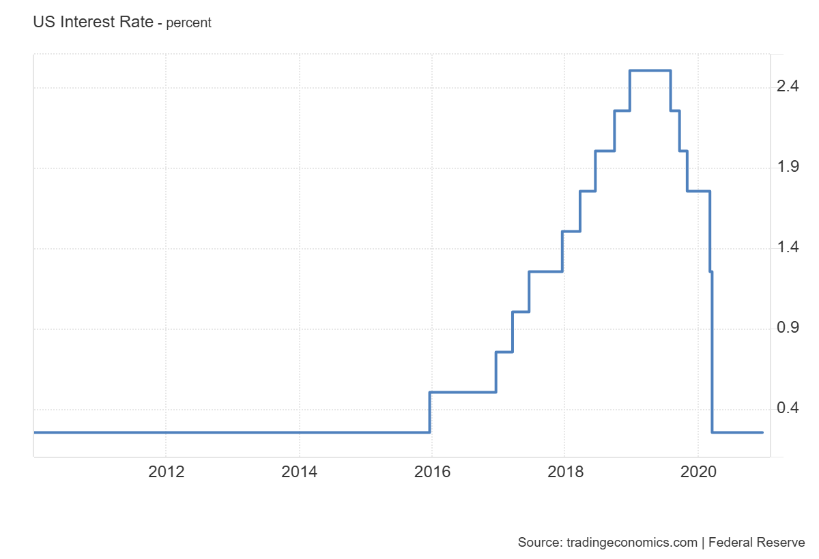
1.2 Data Selection
The two time intervals under consideration are 2011-2015 and 2016-2019.
Most of the data are sourced from the BLS (Bureau of Labor Statistics) website. These include:
Mean annual unemployment rate for each county.
Mean annual CPI for each urban area.
Wording documents of speeches and official announcements are downloaded from the FED (Federal Reserve Board) website.
Federal Reserve (the Fed) announced in late December 2015 that it had commenced an increase in interest rates.

Slide 6
Unemployment rate by states
02

Slide 7
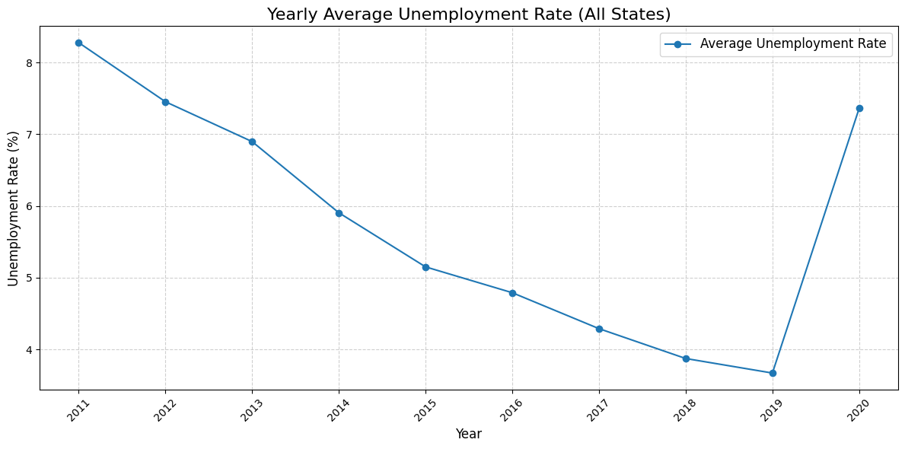
2.1 Outlook of Yearly Average Unemployment Rate Trend

Slide 8
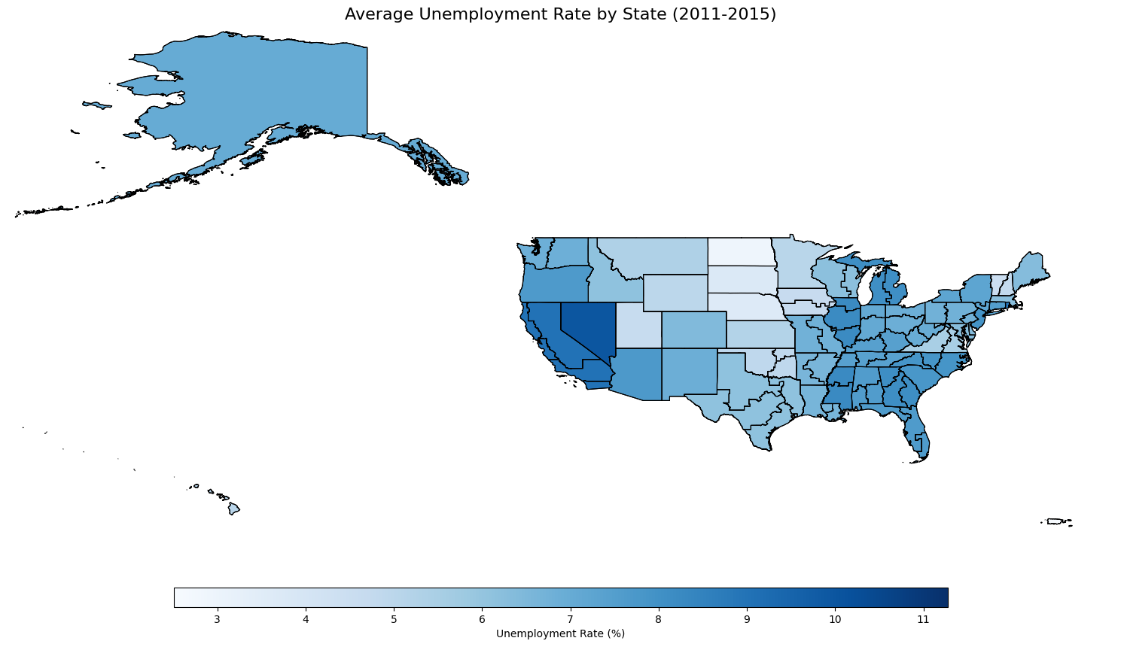
2.2 Average Yearly Unemployment rate by States (2011-2015)

Slide 9
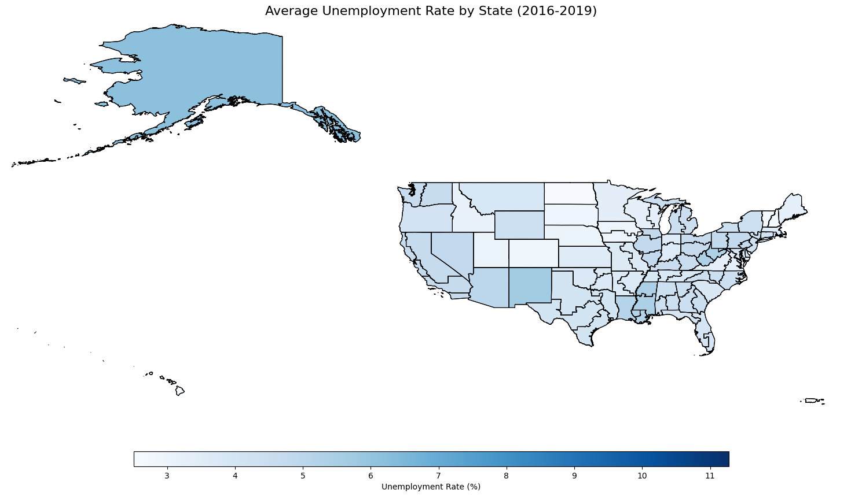
2.3 Average Yearly Unemployment rate by States (2016-2019)

Slide 10
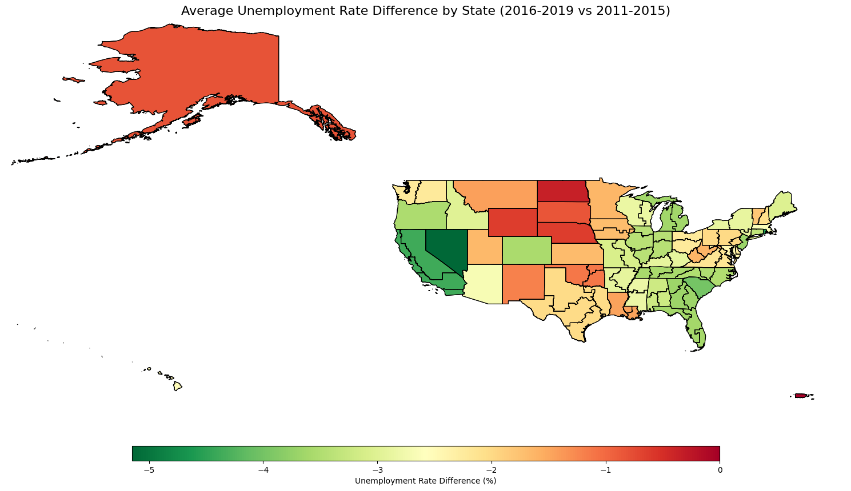
2.4 Average Yearly Unemployment Rate Difference by States (2016-2019 vs 2011-2015)

Slide 11
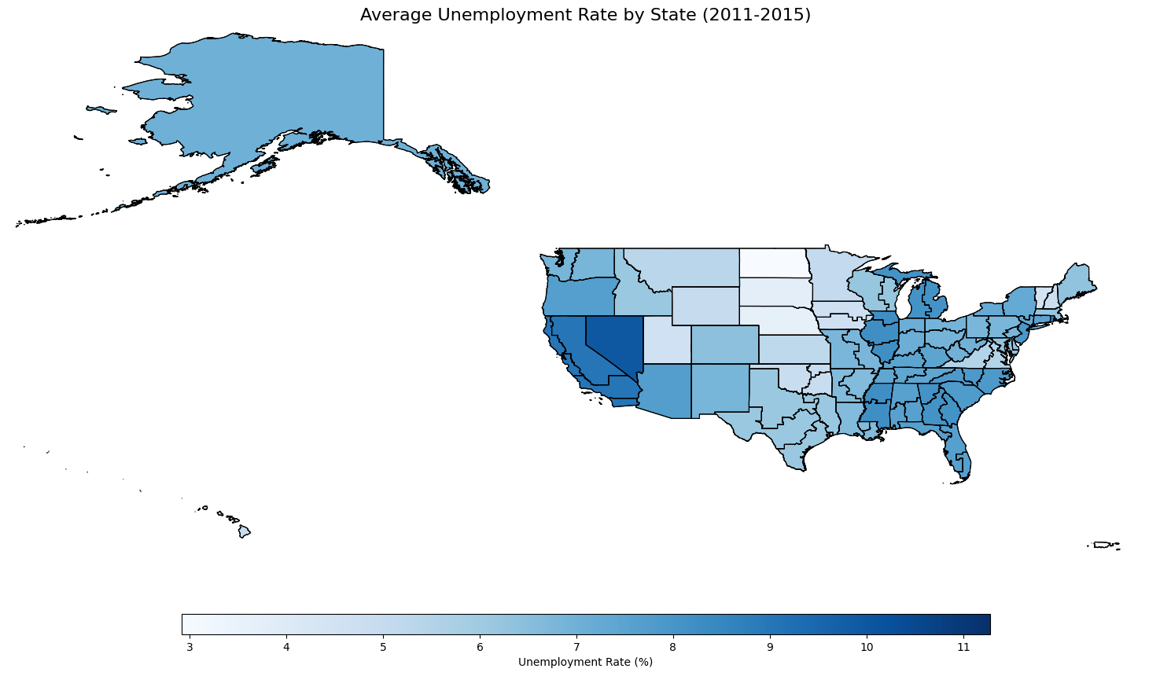
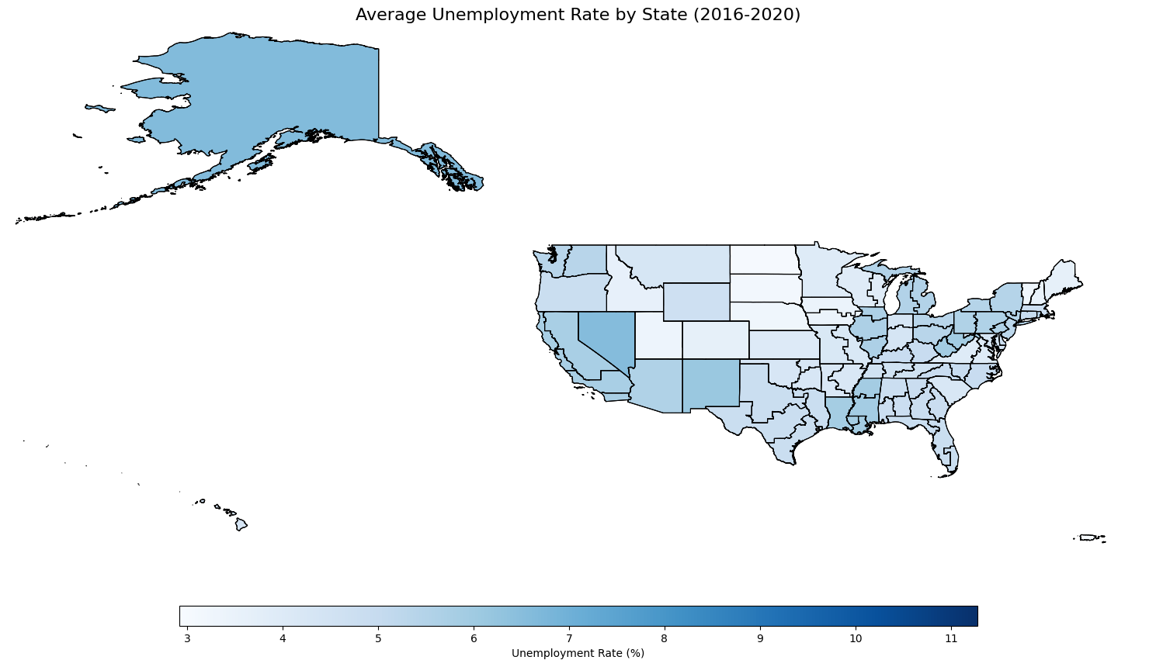
2.5 What if we include the effect of pandemic? (Year of 2020)

Slide 12
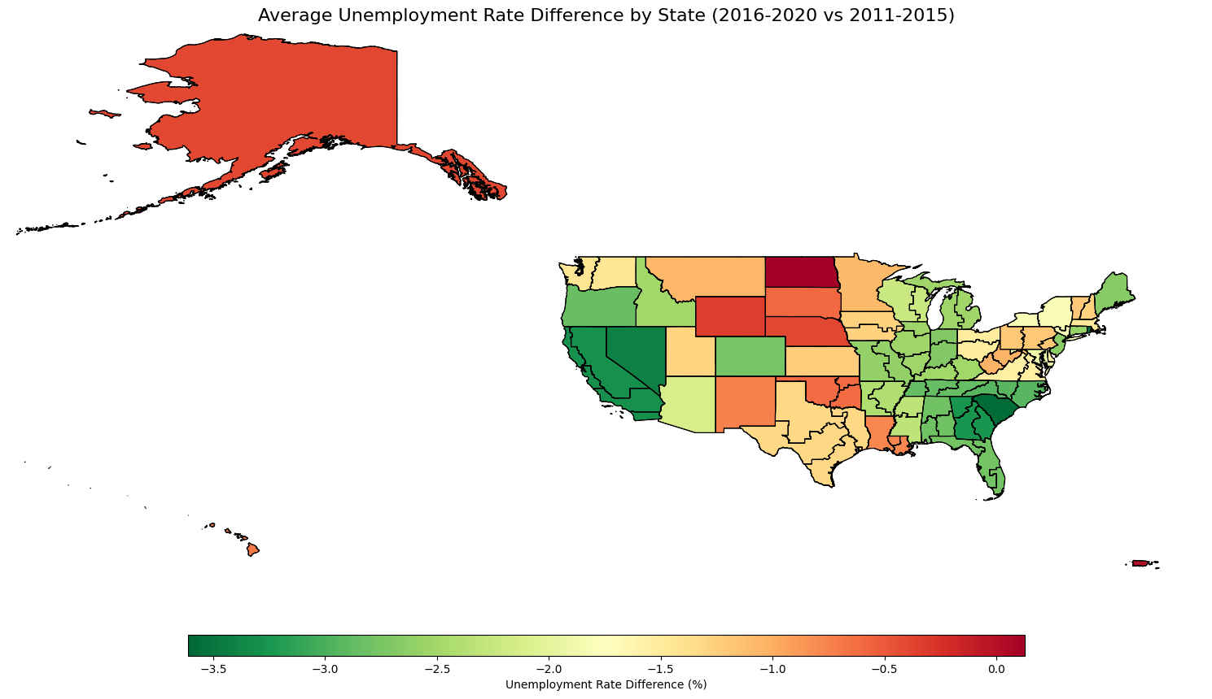
2.6 Following effect of including pandemic data

Slide 13
Consumer Price Index by Urban Areas
03

Slide 14
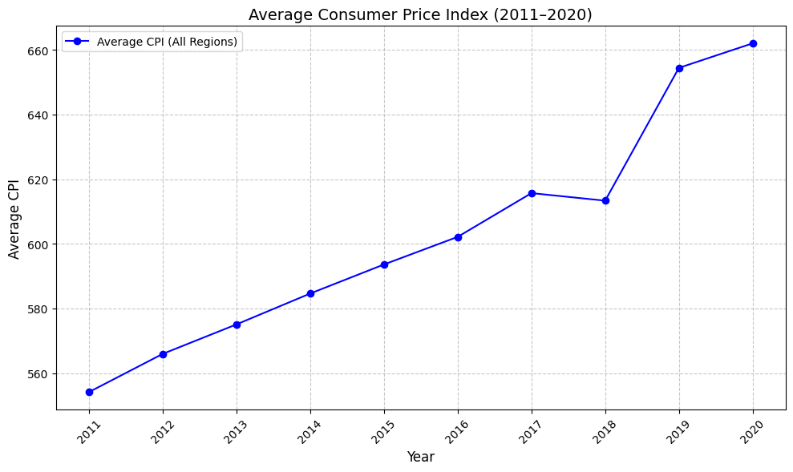
3.1 Outlook of CPI trend

Slide 15
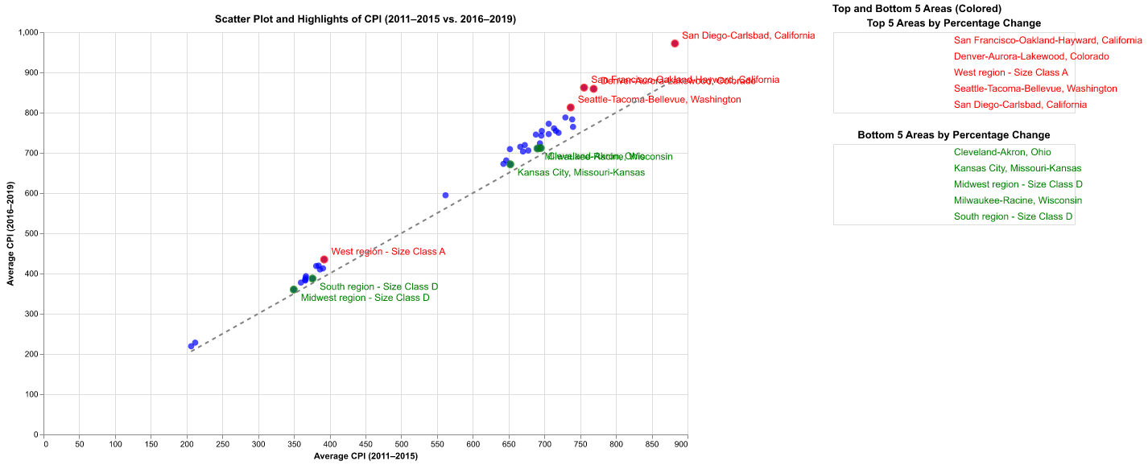
3.2 Analysis of Consumer Price Index

Slide 16
Natural Language Processing
04

Slide 17
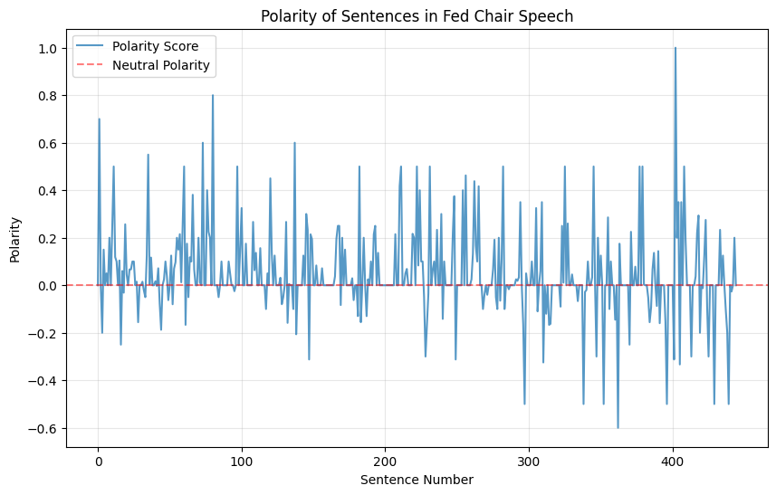
4.1 Polarity Analysis of FED Speech

Slide 18
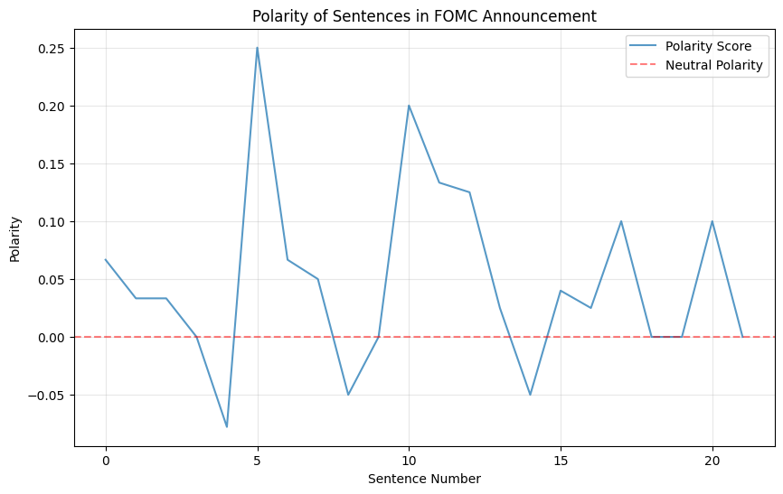
4.2 Polarity Analysis of FED Annoucement

Slide 19
4.3 Specific Wording Counting
Announcement:
Announcement Adjective Counts: [('economic', 8), ('federal', 6), ('FOMC', 4), ('longer', 4), ('monetary', 3), ('moderate', 2), ('recent', 2), ('further', 2), ('maximum', 2), ('gradual', 2)]
Adjectives Percentage: 8.61% of total words
Announcement Modal Counts: [('will', 9), ('should', 1)]，Modals Percentage: 1.29% of total words
Announcement Adverb Counts: [('further', 2), ('however', 1), ('appreciably', 1), ('early', 1), ('partly', 1), ('currently', 1), ('Overall', 1), ('as', 1), ('closely', 1), ('reasonably', 1)]
Adverbs Percentage: 2.19% of total words
Speech:
Speech Adjective Counts: [('federal', 24), ('economic', 24), ('financial', 20), ('median', 15), ('appropriate', 12), ('low', 11), ('further', 10), ('longer', 10), ('monetary', 10), ('transitory', 10)]，Adjectives Percentage: 6.22% of total words
Speech Modal Counts: [('will', 56), ('would', 53), ('could', 11), ('should', 8), ('might', 8), ('may', 7), ('ca', 4), ('’d', 4), ('Could', 3), ('ould', 2)]，Modals Percentage: 1.41% of total words
Speech Adverb Counts: [('So', 33), ('very', 24), ('well', 20), ('so', 18), ('also', 16), ('carefully', 13), ('n', 11), ('longer', 9), ('more', 9), ('as', 8)]，Adverbs Percentage: 3.86% of total words

Slide 20
Thank you for your patience while listening
Presentation: Group 58
Qiyin Yao (Kevin Yao)
Dizhe Xia (Dylan Xia)
Yuqing Wen

